Slide 1
Food-101 Image Classification using Transfer Learning
Project Presentation

Slide 2
📊 Dataset Summary
Food-101
The Food-101 dataset consists of 101 food categories with 1,000 images per class.
For this project, I filtered the dataset to include only the first 20 classes.

Slide 3
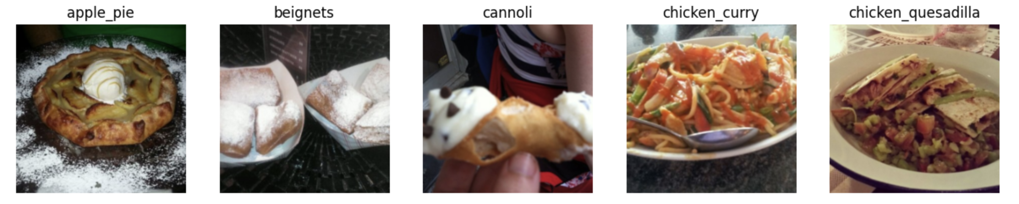
📊 Dataset Summary

Slide 4

📊 Dataset Summary

Slide 5
📊 Dataset Summary
🖖 Dataset Split:
- Training set: 80% of the filtered dataset
- Validation set: 20% of the filtered dataset
- Test set: 2000 images from the filtered dataset
🤖 Transformations Applied:
- Resize to 256x256 pixels
- Center crop to 224x224 pixels
- Normalize using mean [0.485, 0.456, 0.406] and std [0.229, 0.224, 0.225]

Slide 6
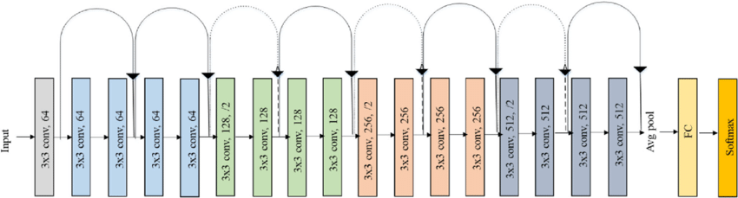
🏛️ Model Architecture

Slide 7
🏛️ Model Architecture
nn.Dropout(0.5)
nn.Linear( features, 20)

Slide 8
🏛️ Changing the Architecture
Initial Model Architecture
Replaced the last fully connected layer to match the number of classes (20)
All layers except the final fully connected layer were frozen during the initial training phase.
Optimizer: Adam
Final Model Architecture
Replaced the last fully connected layer to match the number of classes (20)
All hidden layers were unfrozen 🫠 during the training phase.
Optimizer: SGD
No Softmax as used CrossEntropyLoss which applies Softmax internally
Notes:
nn.CrossEntropyLoss as the loss function. This loss function expects raw logits (the outputs of the final Linear layer without activation) and internally applies the Softmax function to compute the probabilities and the log-likelihood loss.

Slide 9
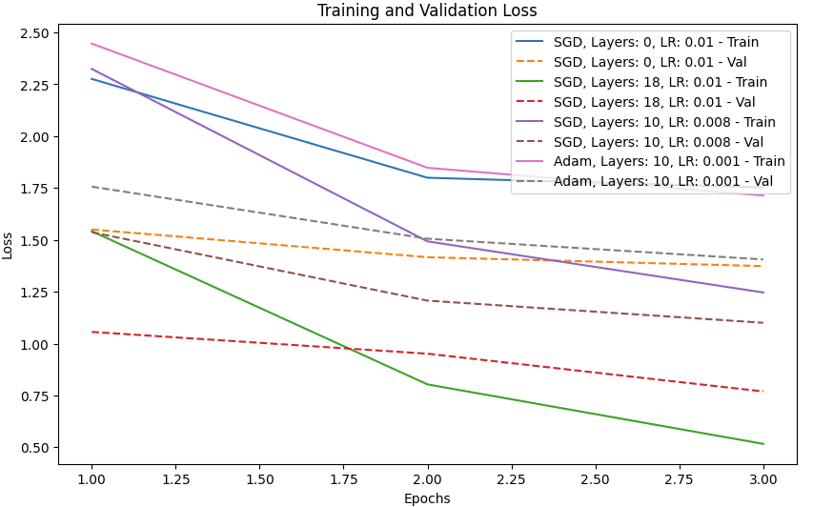
🏋️‍♂️ Training and Validation

Slide 10
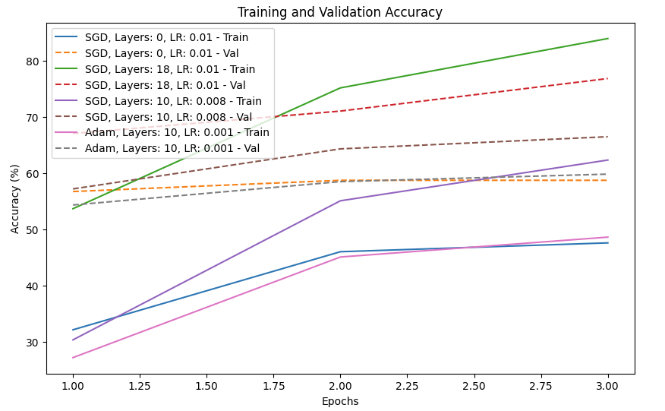
🏋️‍♂️ Training and Validation

Slide 11
🏋️‍♂️ Training Process
Along with hyperparameter tuning (learning rate, epochs, batch size), the training process involved:
Experimenting with optimizers (Adam and SGD)
Unfreezing varying number of hidden layers in the ResNet18 model.

Slide 12
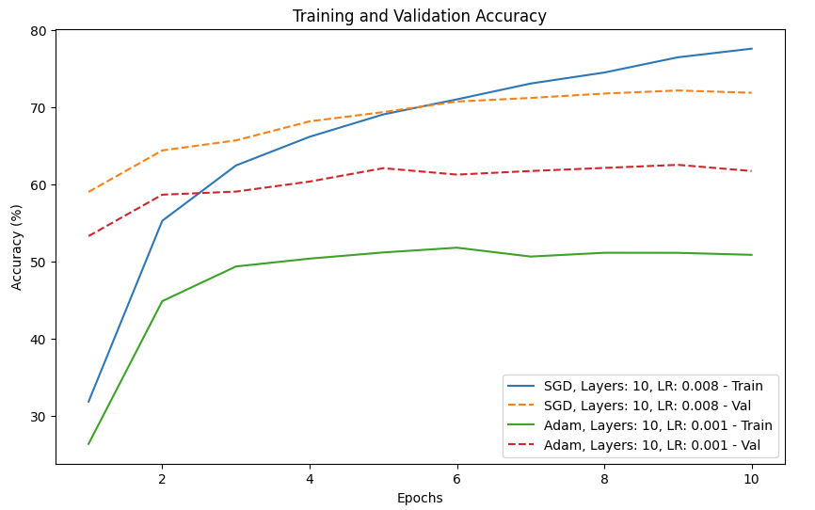
📻 Fine Tuning and Reflections

Slide 13
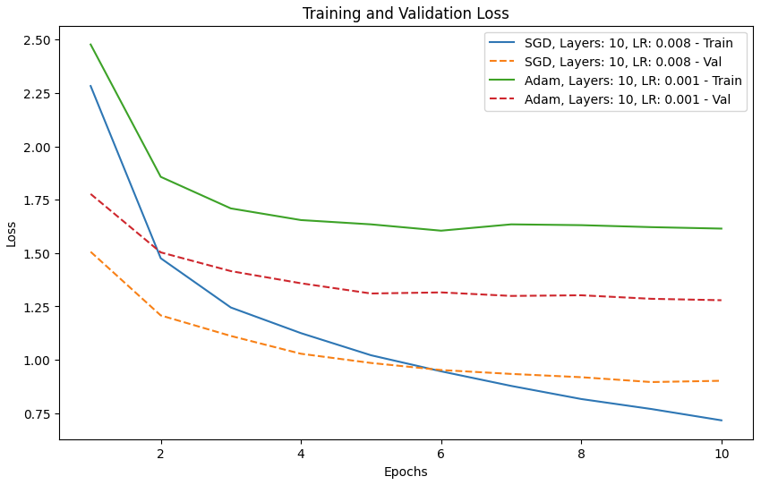
📻 Fine Tuning and Reflections

Slide 14
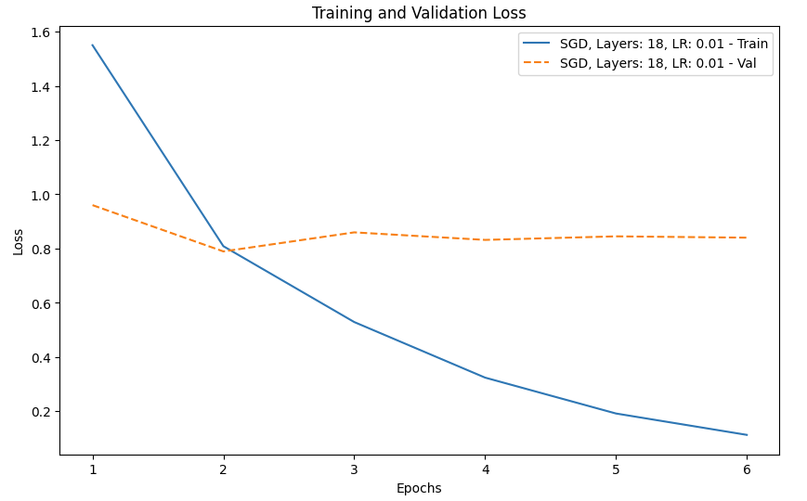
📻 Fine Tuning and Reflections

Slide 15
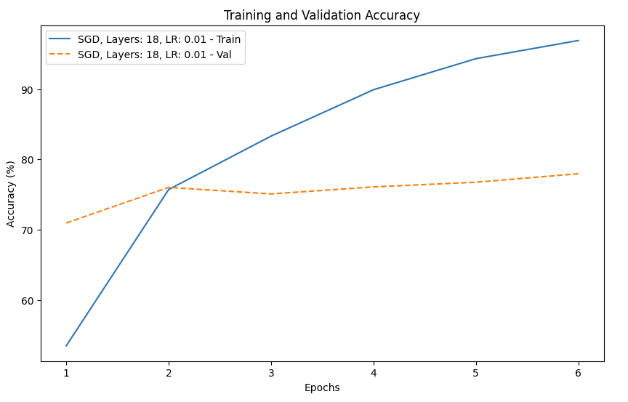
📻 Fine Tuning and Reflections

Slide 16
🤔 Lessons Learned
Model was prone to memorizing as the epochs went on.
Data preprocessing is significant!
Unfreezing all the layers helped.
Data augmentation of some sort would have helped.

Slide 17
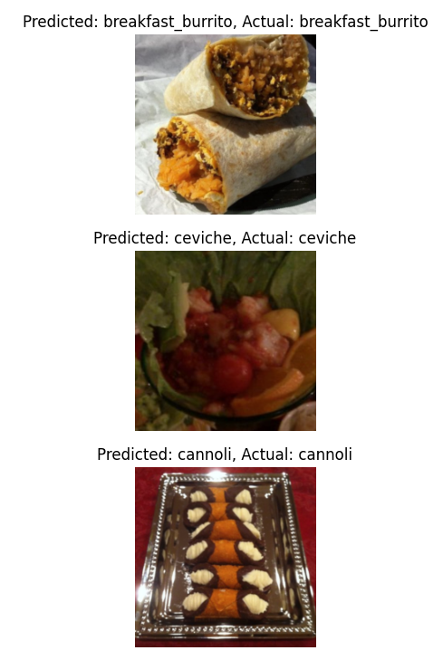
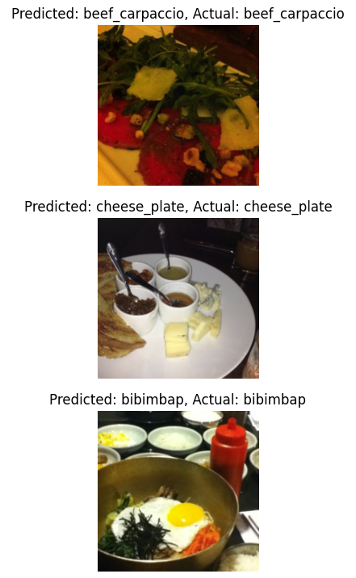
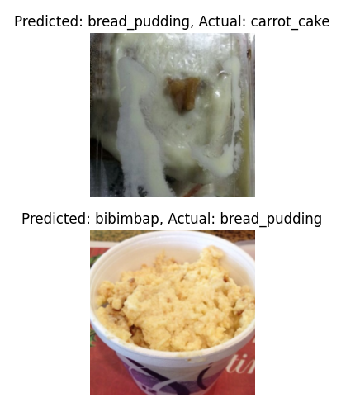
🩺 Test Results
Accuracy: 0.8005 | Precision: 0.8056 | Recall: 0.8005 | F1-Score: 0.7979

